Slide 1
https://codeburst.io/algorithms-i-searching-and-sorting-algorithms-56497dbaef20

Slide 2
CSS143 Computer Programming (II)

Slide 3

Comparison
”My car is faster than yours!”

Slide 4
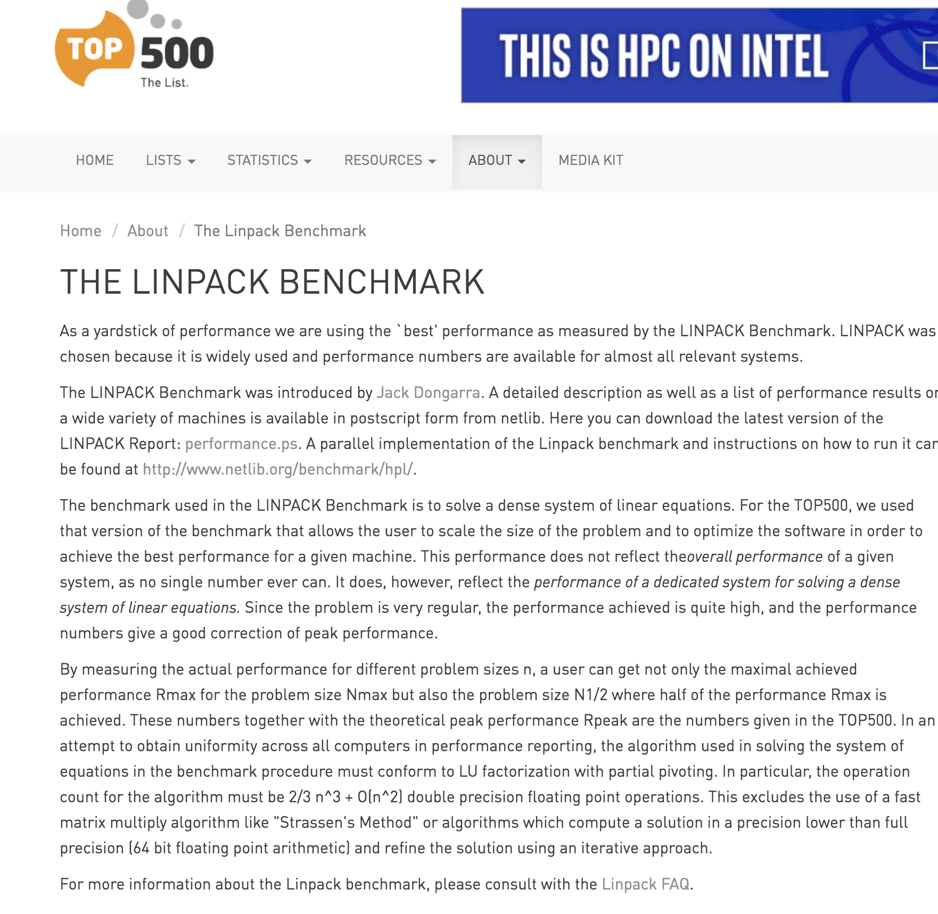
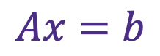
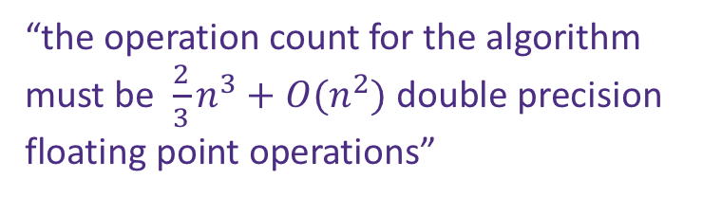
Comparison
”My computer is faster than yours!”
$$Ax=b$$
“the operation count for the algorithm must be $\frac{2}{3}n^{3}+O(n^{2})$ double precision floating point operations”

Slide 5
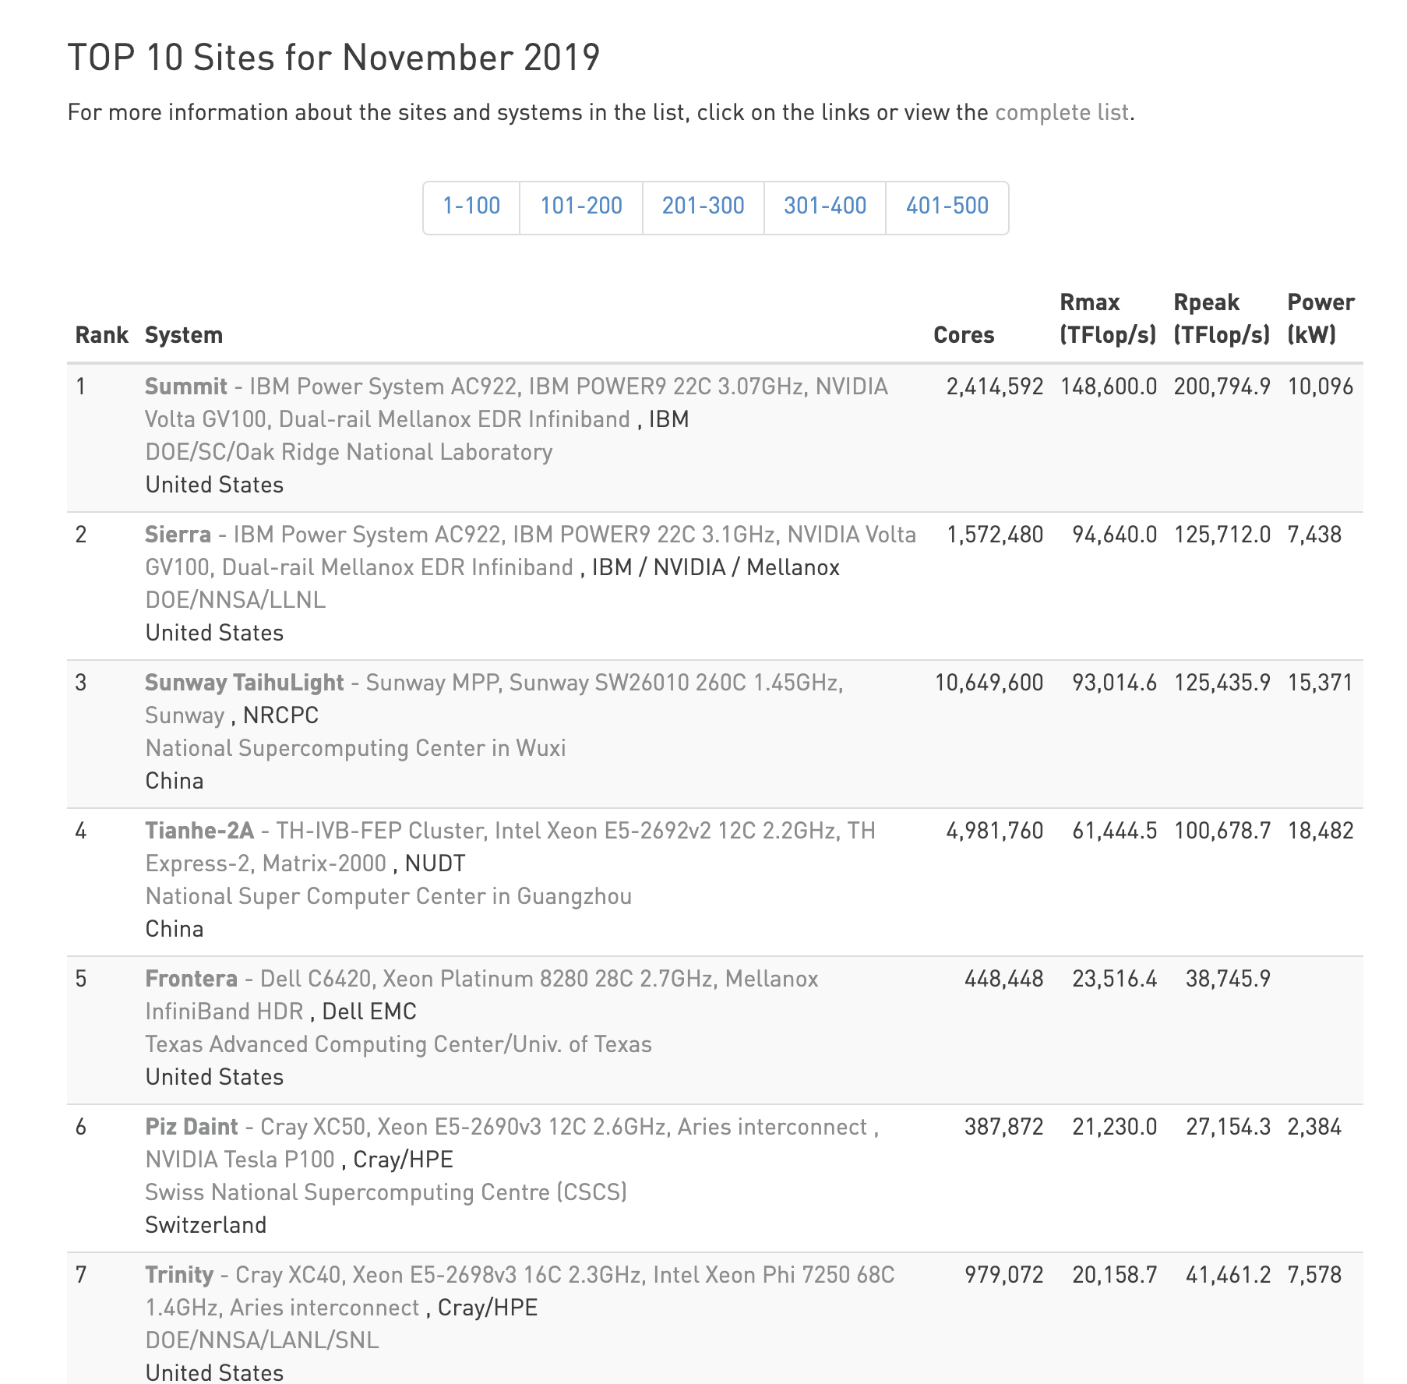
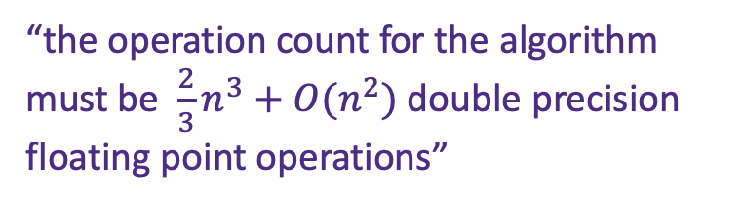
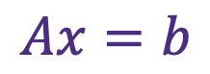
Comparison
”My computer is faster than yours!”
$$Ax=b$$
“the operation count for the algorithm must be $\frac{2}{3}n^{3}+O(n^{2})$ double precision floating point operations”

Slide 6
Comparison
”merge sort is faster than insertion sort!”
”This algorithm is faster than that algorithm!”

Slide 7
Comparison
What does the big-O notation mean?
Which sorting is faster, insertion sort or bubble sort?
What does it mean ”quick sort is not stable”?
Does merge sort require O(1) space?
High Performance Computing 101

Slide 8
The Bubble Sort Story
http://computationaltales.blogspot.com/2011/04/bullies-bubble-sort-and-soccer-tickets.html

Slide 9
Sorting Algorithm
Given a set of random number, how to sort it?
Descending Order
1
3
How many comparison?

Slide 10
Sorting Algorithm
Given a set of random number, how to sort it?
Descending Order
1
3
5
1

Slide 11
Sorting Algorithm
Given a set of random number, how to sort it?
Descending Order
3
5
1
How many comparison?

Slide 12
Sorting Algorithm
Given a set of random number, how to sort it?
Descending Order
1
5
7
8
5
7
8
1
7
8
5
1
8
7
5
1
How many comparison?

Slide 13
Sorting Algorithm
Given a set of random number, how to sort it?
Descending Order
x₁
x₂
x₃
……
x_{n}
How many comparison?

Slide 14
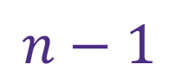


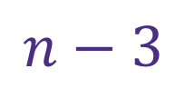
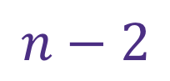
Sorting Algorithm
Given a set of random number, how to sort it?
x₁
x₂
x₃
……
x$N$
$$n−1$$
1st round:
$$n−2$$
2nd round:
$$n−3$$
3rd round:
……
……
N^{th} round:
$$1$$

Slide 15
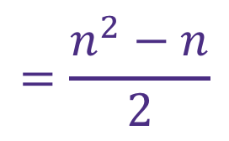
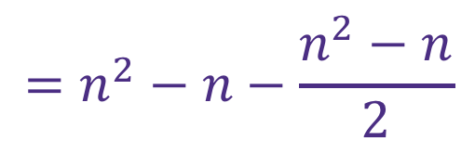
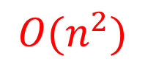
Sorting Algorithm
Given a set of random number, how to sort it?
x₁
x₂
x₃
……
x$N$
$$\left(n−1\right)+\left(n−2\right)+\left(n−3\right)+…+2+1$$
$$\left(n−1\right)+\left(n−2\right)+\left(n−3\right)+…+2+1$$
$$\left(n−1\right)+\left(n−2\right)+…+(n−\left(n−2\right))+(n−\left(n−1\right))$$
$$=\left(n−1\right)×n−(1+2+3+…+\left(n−1\right))$$
$$=n^{2}−n−\frac{n^{2}−n}{2}$$
$$=\frac{n^{2}−n}{2}$$
$$O(n^{2})$$

Slide 16
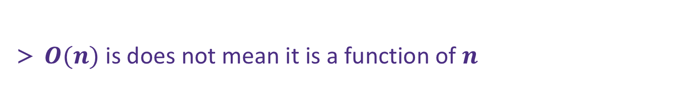
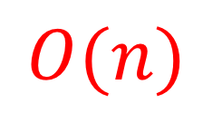
Big O notation
$$O(n)$$
“O” read as “order of”
used to classify algorithms according to how their running time or space requirements grow as the input size grows
used to classify algorithms according to how their running time or space requirements grow as the input size grows
$O(n)$ is does not mean it is a function of $n$

Slide 17
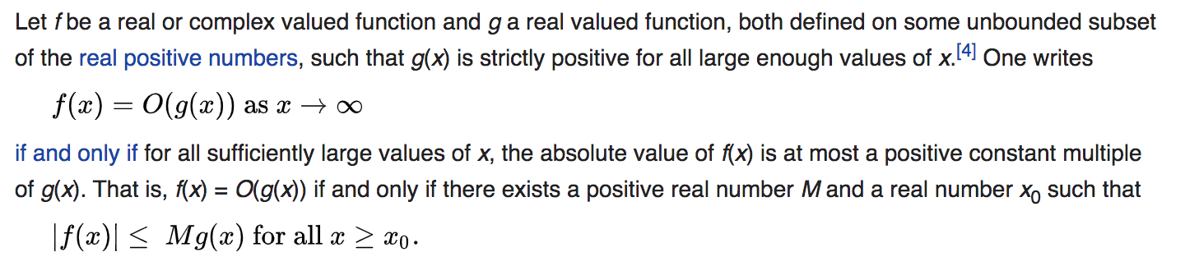
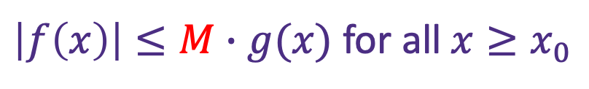

Big O
Big O notation
“O” read as “order of”
$$O(n)$$
A positive number $M$ exists such that:
$\left|f\left(x\right)\right|≤M∙g(x)$ for all $x≥x_{0}$

Slide 18
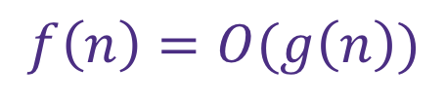
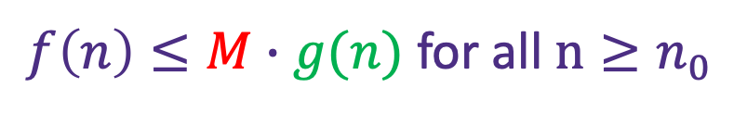
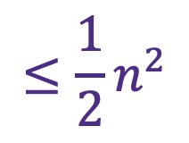
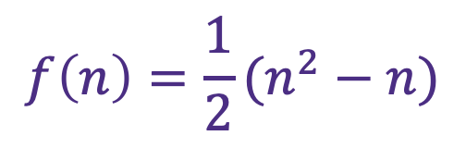
Big O
$$f\left(n\right)=O(g\left(n\right))$$
If and only if there exists a positive number $M$ exists such that:
$f\left(n\right)≤M∙g(n)$ for all $n≥n_{0}$
$$f\left(n\right)=\frac{1}{2}(n^{2}−n)$$
$$≤\frac{1}{2}n^{2}$$

Slide 19
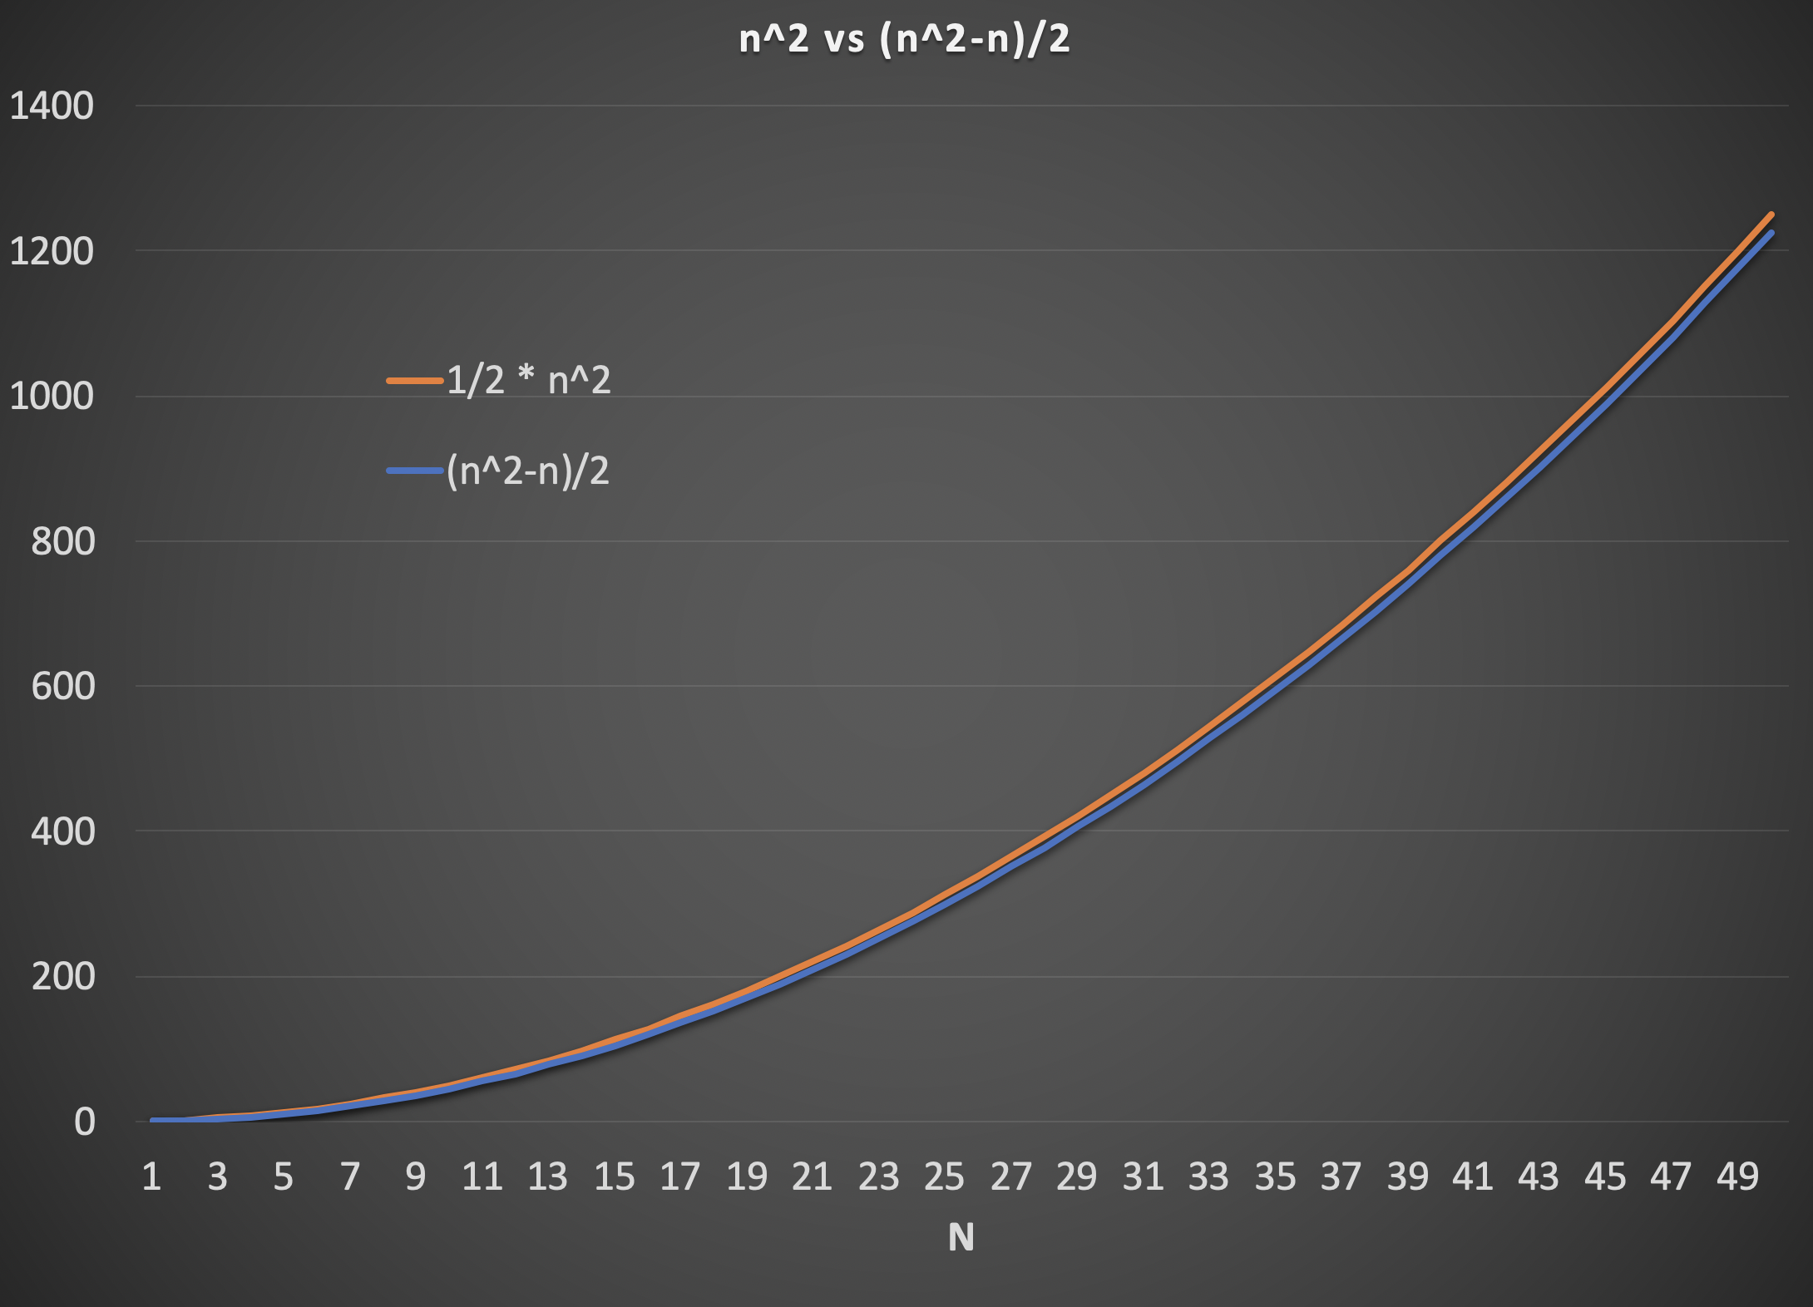
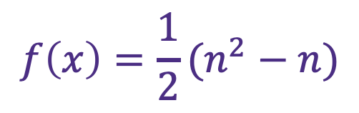
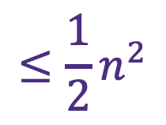
$$f\left(x\right)=\frac{1}{2}(n^{2}−n)$$
$$≤\frac{1}{2}n^{2}$$

Slide 20
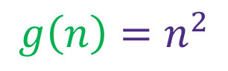
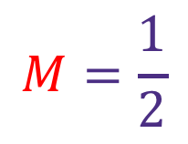
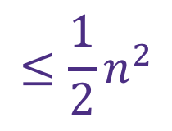
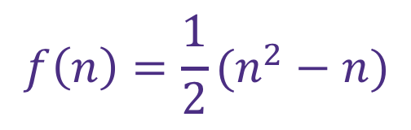
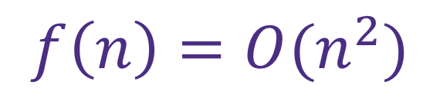
Big O
$$f\left(n\right)=O(g\left(n\right))$$
If and only if there exists a positive number $M$ exists such that:
$f\left(n\right)≤M∙g(n)$ for all $n≥n_{0}$
$$M=\frac{1}{2}$$
$$f\left(n\right)=\frac{1}{2}(n^{2}−n)$$
$$≤\frac{1}{2}n^{2}$$
$$g\left(n\right)=n^{2}$$
$$f\left(n\right)=O(n^{2})$$

Slide 21
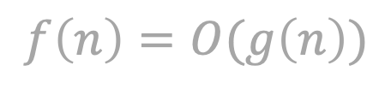
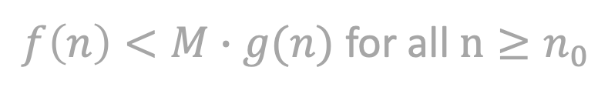
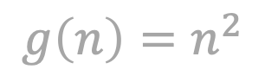
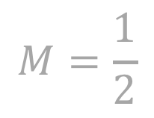
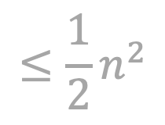
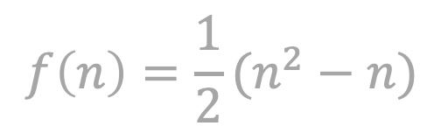
Big O
$$f\left(n\right)=O(g\left(n\right))$$
If and only if there exists a positive number $M$ exists such that:
$f\left(n\right)<M∙g(n)$ for all $n≥n_{0}$
$$M=\frac{1}{2}$$
$$f\left(n\right)=\frac{1}{2}(n^{2}−n)$$
$$≤\frac{1}{2}n^{2}$$
$$g\left(n\right)=n^{2}$$
$$f\left(n\right)=O(n^{2})$$

Slide 22
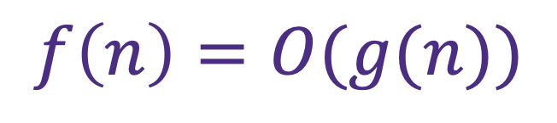
Big O
$$f\left(n\right)=O(g(n))$$
https://xlinux.nist.gov/dads/HTML/bigOnotation.html

Slide 23
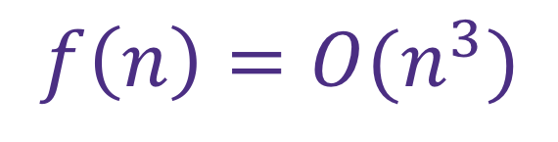
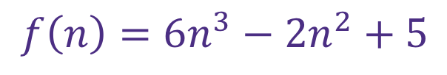
Big O
$$f\left(n\right)={6n}^{3}−2n^{2}+5$$
$$f\left(n\right)=O(n^{3})$$
https://english.stackexchange.com/questions/267264/how-do-you-explain-cubic-growth-of-a-function

Slide 24
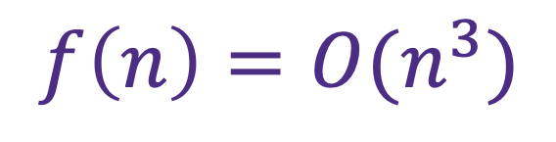
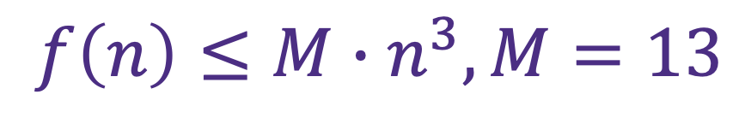
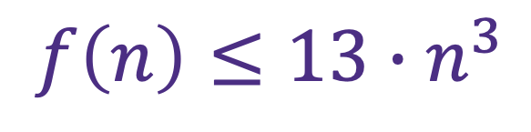
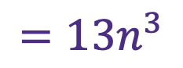
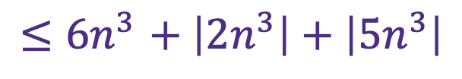
Big O
$$f\left(n\right)={6n}^{3}−2n^{2}+5$$
$${≤6n}^{3}+ \left|2n^{3}\right|+\left|5n^{3}\right|$$
$${=13n}^{3}$$
$$f\left(n\right)≤13{∙n}^{3}$$
$$f\left(n\right)≤M{∙n}^{3}, M=13$$
$$f\left(n\right)=O(n^{3})$$

Slide 25
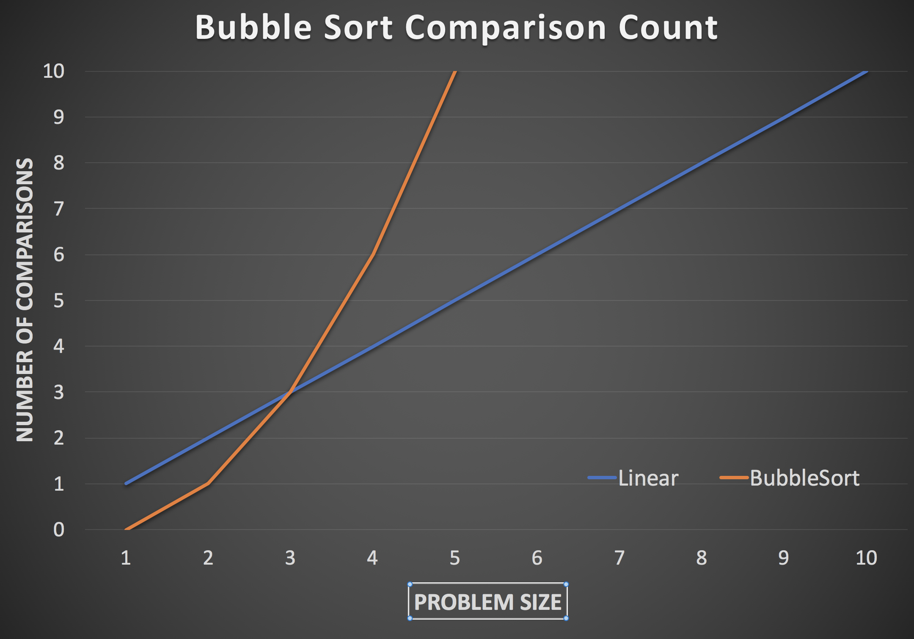
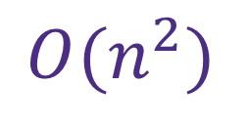
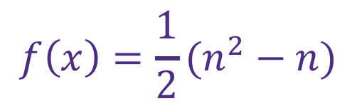
Bubble Sort Complexity
$$f\left(x\right)=\frac{1}{2}(n^{2}−n)$$
$$O(n^{2})$$

Slide 26
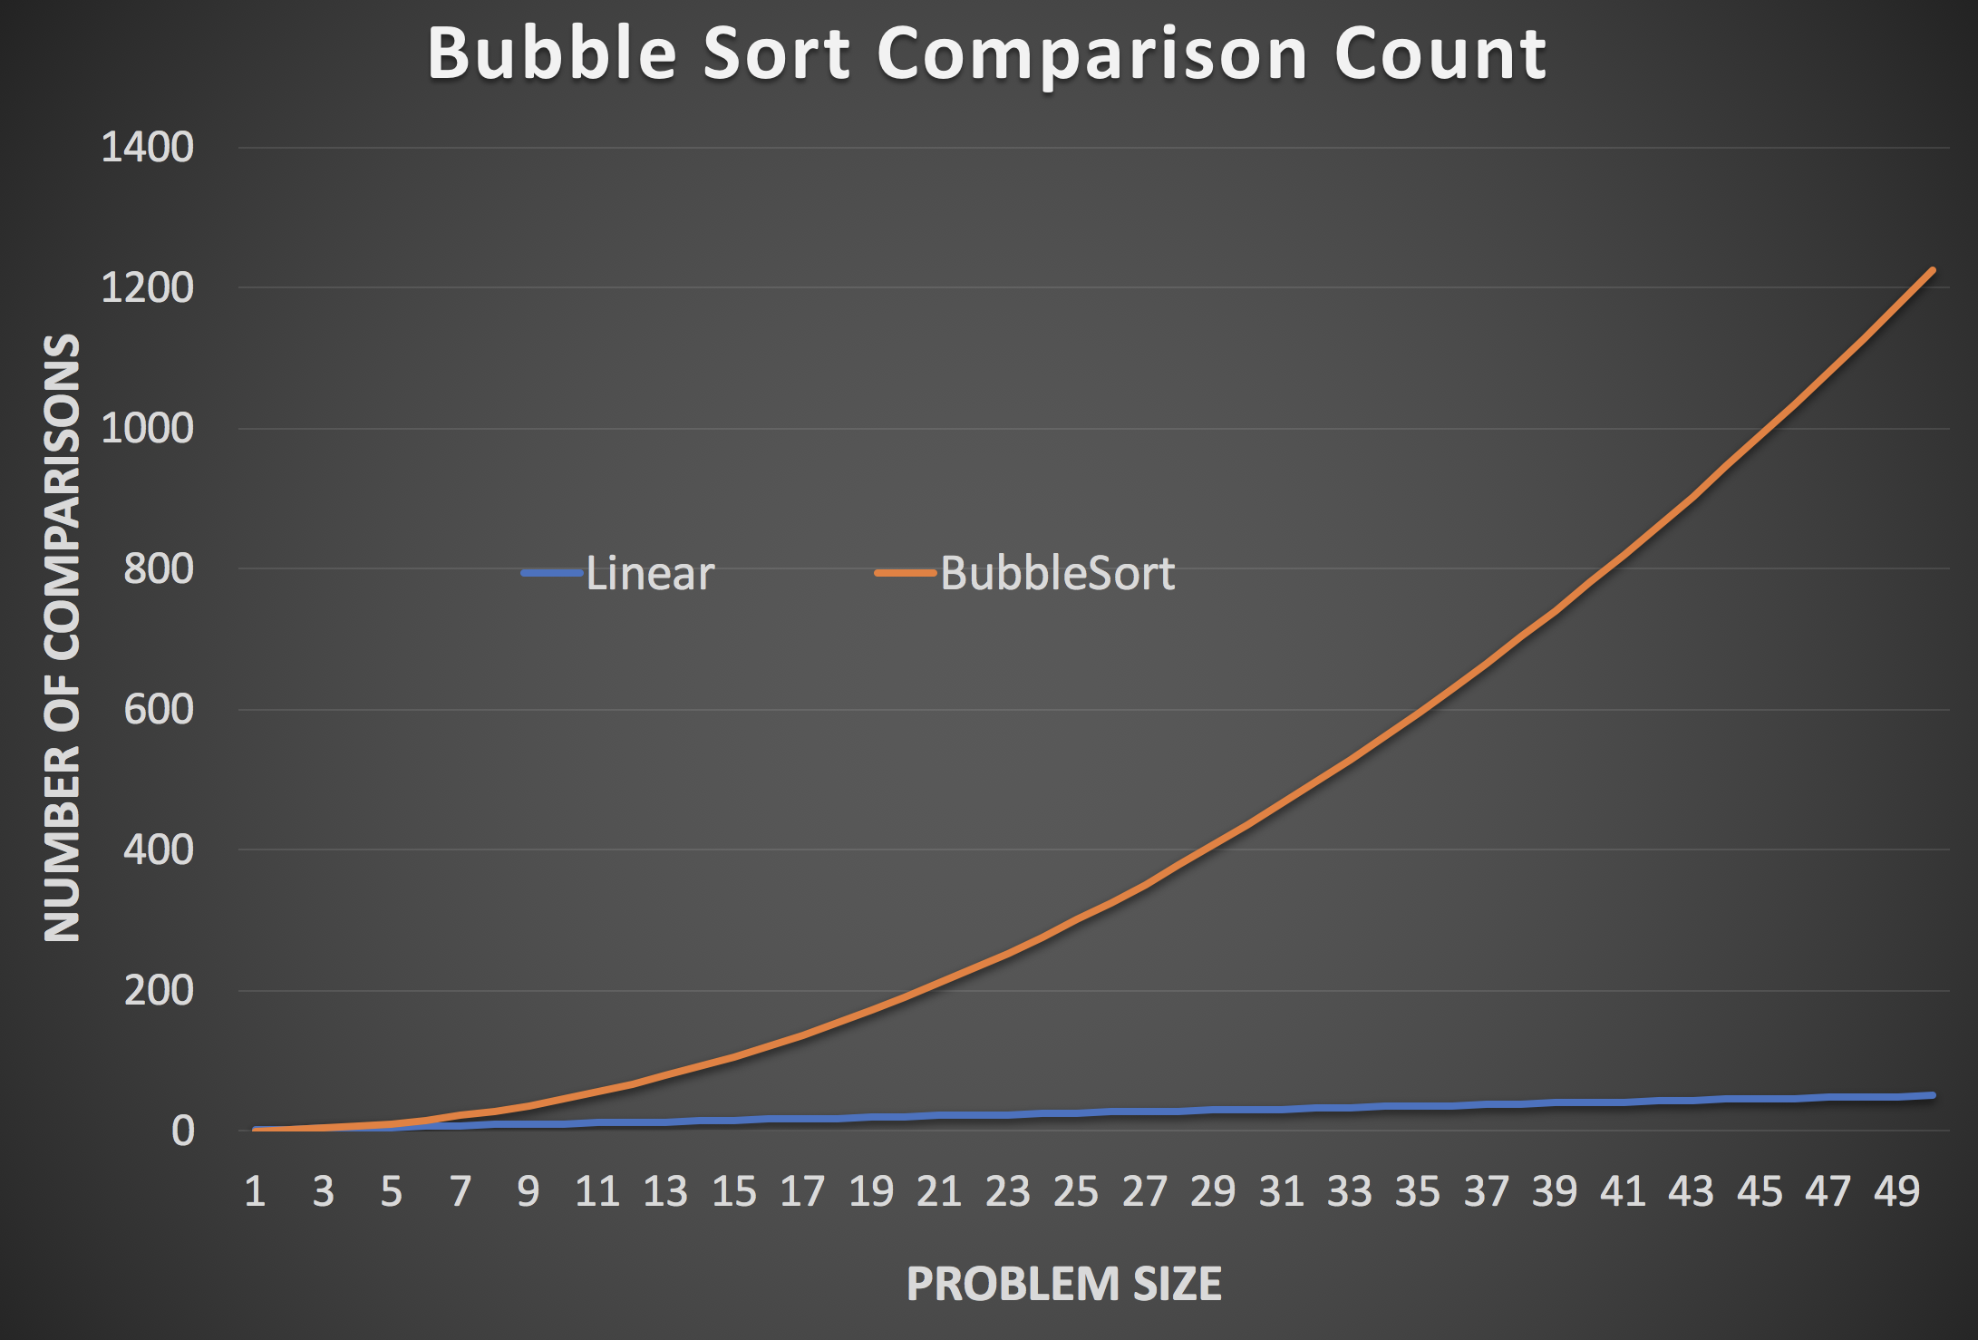

Bubble Sort Complexity
$$O(n^{2})$$

Slide 27
Insertion Sort
Insert number one by one to their proper location
1
8
6
3
2
7

Slide 28
Insertion Sort
Insert number one by one to their proper location
1
6
8
3
2
7

Slide 29
Insertion Sort
Insert number one by one to their proper location
1
3
6
8
2
7

Slide 30
Insertion Sort
Insert number one by one to their proper location
1
2
3
6
8
7

Slide 31
Insertion Sort
Insert number one by one to their proper location
1
2
3
6
7
8

Slide 32



Insertion Sort complexity
Descending Order
1
2
3
4
6
7
$$1$$
2
1
3
4
6
7
$$2$$
2
1
3
4
6
7
$$3$$
……
……

Slide 33
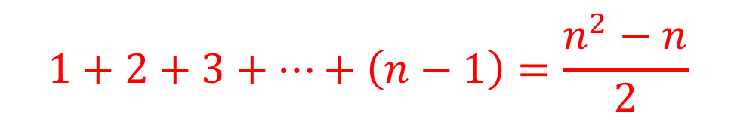
Insertion Sort complexity
Descending Order
1
2
3
4
6
7
$$1$$
2
1
3
4
6
7
$$2$$
2
1
3
4
6
7
$$3$$
$$1+2+3+…+\left(n−1\right)=\frac{n^{2}−n}{2}$$

Slide 34
Insertion Sort

Slide 35
Insertion Sort
http://computationaltales.blogspot.com/2011/04/why-tailors-use-insertion-sort.html

Slide 36
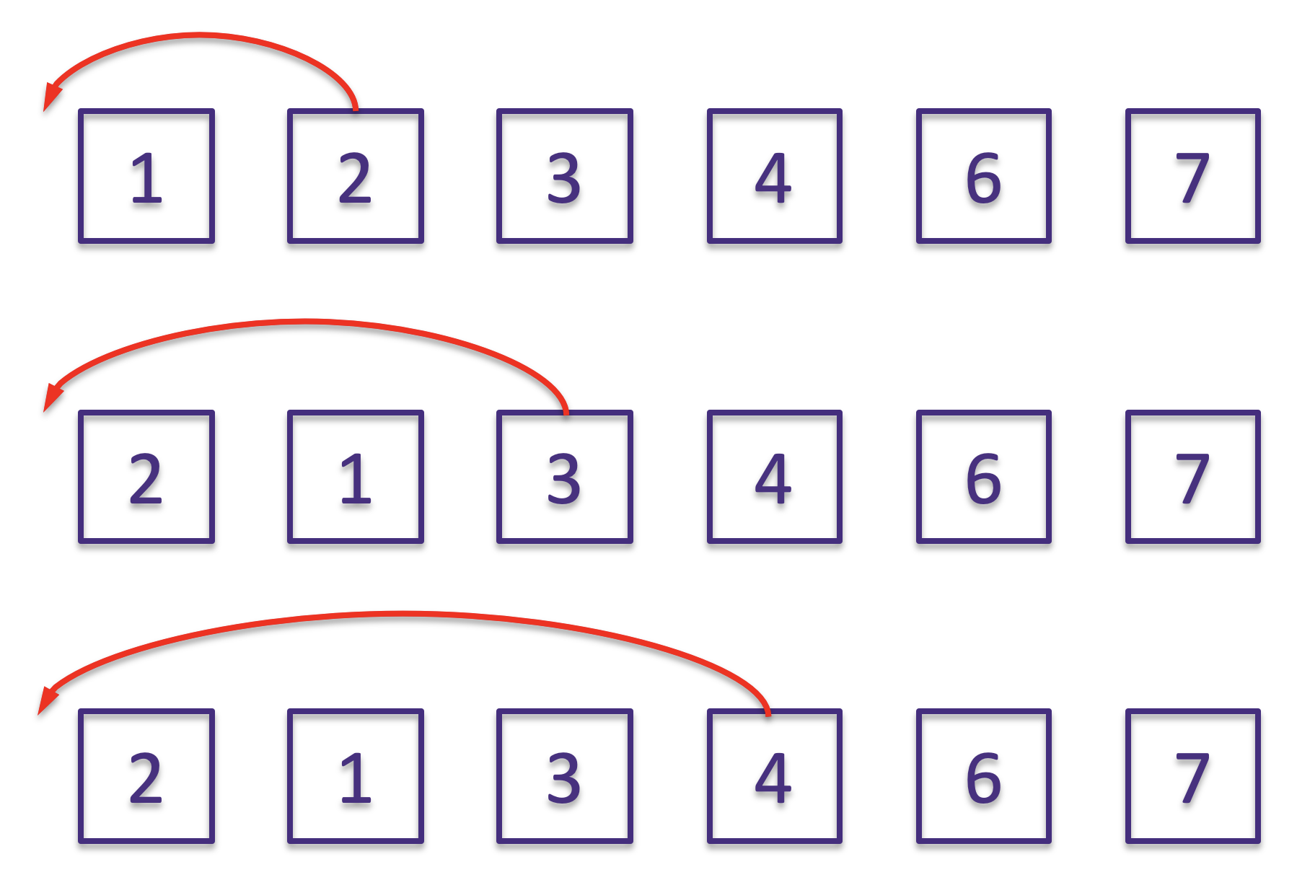
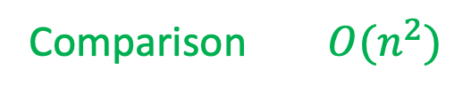
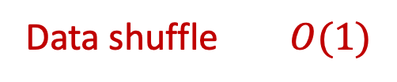

Insertion Sort
Array
LinkedList
Comparison $O(n^{2})$
Data shuffle $O(n^{2})$
Comparison $O(n^{2})$
Data shuffle $O(1)$

Slide 37
Can we do better?
Bubble
Insertion
3
6
1
8
8
7
9

Slide 38
Can we do better?
Bubble
Insertion
8
8
7
3
6
9
6
1

Slide 39
Can we do better?
Bubble
Insertion
9
8
7
3
6
1
Quick Sort

Slide 40
Quick Sort

Slide 41

Quick Sort
Find a pivot element
Move some to left, and others to right of the pivot
Repeat
Recursion into the left of the pivot
Recursion into the right of the pivot
$$T\left(n\right)=c∙n+2T(\frac{n}{2})$$
Pivot and swap
Recursion on both sides

Slide 42



Quick Sort
But can you find pivot that finishes pivoting and swapping in $O\left(n\right)?$
$$T\left(n\right)=c∙n+2T(\frac{n}{2})$$
Pivot and swap
Recursion on both sides
Average case: $nlogn$
https://brilliant.org/wiki/master-theorem/

Slide 43


Quick Sort
$$nlogn$$
Average Case
Worse Case:
$$n^{2}$$
9
8
7
3
6
1

Slide 44




Exercise
What’s the complexity of binary search $T(n)$
$$T\left(n\right)=T\left(\frac{n}{2}\right)+1$$
$$O(logn)$$
$$a=1$$
$$b=2$$

Slide 45
Stability of Sorting
Stable sort algorithms sort repeated elements in the same order that they appear in the input

Slide 46
Merge Sort

Slide 47




Merge Sort Complexity
$$2×T(\frac{n}{2})$$
$$T\left(n\right)=$$
$$+n$$
Worse case
$$O(nlogn)$$

Slide 48


Sorting Complexity
$$O\left(n\right) vs O\left(nlogn\right) vs O(n^{2})$$

Slide 49
Merge Sort
The merging step
1
1
3
3
5
5
9
9
2
2
4
4
6
6
10
10
12
12
1
2
3
4
5
6
9
10
12

Slide 50

Sorting Algorithm

Slide 51



The ${O(n}^{3})$ Star of Matrix Multiple
$$\left[\begin{matrix}a_{11} & a_{12} \\ a_{21} & a_{22}\end{matrix}\right]×\left[\begin{matrix}b_{11} & b_{12} \\ b_{21} & b_{22}\end{matrix}\right]$$
= $\left[\begin{matrix}{a_{11}b}_{11}+a_{12}b_{21} & {a_{11}b}_{12}+a_{12}b_{22} \\ {a_{21}b}_{11}+a_{22}b_{21} & {a_{21}b}_{12}+a_{22}b_{22}\end{matrix}\right]$

Slide 52




The ${O(n}^{3})$ Star of Matrix Multiple
$$\left[\begin{matrix}a_{11} & a_{12} \\ a_{21} & a_{22}\end{matrix}\right]×\left[\begin{matrix}b_{11} & b_{12} \\ b_{21} & b_{22}\end{matrix}\right]$$
= $\left[\begin{matrix}{a_{11}b}_{11}+a_{12}b_{21} & {a_{11}b}_{12}+a_{12}b_{22} \\ {a_{21}b}_{11}+a_{22}b_{21} & {a_{21}b}_{12}+a_{22}b_{22}\end{matrix}\right]$
Compute: ${O(n}^{3})$
Compute: ${O(n}^{3})$
Space: ${O(n}^{2})$
Space: ${O(n}^{2})$

Slide 53



The ${O(n}^{3})$ Star of Matrix Multiple
Compute: ${O(n}^{3})$
Space: ${O(n}^{2})$

Slide 54




The ${O(n}^{3})$ Star of Matrix Multiple
Compute: ${O(n}^{2})$
Space: ${O(n}^{2})$
Load Data
Compute
Load Data
Compute
Compute: ${O(n}^{3})$
Space: ${O(n}^{2})$
Load Data
Compute
“HPC"
Load Data

Slide 55

Numerical High Performance Computing
http://www.icl.utk.edu/

Slide 56

Numerical High Performance Computing
https://www.icl.utk.edu/files/print/2019/magma-sc19.pdf

Slide 57
Homework 6 Review
Doc 0 : "hello world", Doc 1 : "hello", Doc 2 : "world", Doc 3 : "world world hello", Doc 4 : "seattle rains hello abc world", Doc 5: "sunday hello world fun"
Search “hello world”

Slide 58
Homework 6 Review
Doc 0 : "hello world", Doc 1 : "hello", Doc 2 : "world", Doc 3 : "world world hello", Doc 4 : "seattle rains hello abc world", Doc 5: "sunday hello world fun"
Search “hello world”

Slide 59

Homework 6 Review
Doc 0 : "hello world", Doc 1 : "hello", Doc 2 : "world", Doc 3 : "world world hello", Doc 4 : "seattle rains hello abc world", Doc 5: "sunday hello world fun"
Search “hello world”
Indexing:
word → document + location
hello → document{0, location{0}}
document{1, location{0}}
document{3, location{2}}
document{4, location{2}}
document{5, location{1}}

Slide 60
Homework 6 Review
Doc 0 : "hello world", Doc 1 : "hello", Doc 2 : "world", Doc 3 : "world world hello", Doc 4 : "seattle rains hello abc world", Doc 5: "sunday hello world fun"
Search “hello world”
Indexing:
word → document + location
hello → doc{0, location{0}}
doc{1, location{0}}
doc{3, location{2}}
doc{4, location{2}}
doc{5, location{1}}
world → doc{0, location{1}}
doc{2, location{0}}
doc{3, location{0, 1}}
doc{4, location{4}}
doc{5, location{2}}

Slide 61
Homework 6 Review
hello → doc{0, location{0}}
doc{1, location{0}}
doc{3, location{2}}
doc{4, location{2}}
doc{5, location{1}}
world → doc{0, location{1}}
doc{2, location{0}}
doc{3, location{0, 1}}
doc{4, location{4}}
doc{5, location{2}}
Search “hello world”
Step one : document lists
{0, 1, 3, 4, 5}
{0, 2, 3, 4, 5}
hello
world
{0, 3, 4, 5}
doc containing both “hello” and “world"
Intersection of lists

Slide 62
Homework 6 Review
Search “hello world”
{0, 3, 4, 5}
Doc containing both “hello” and “world"
hello → doc{0, location{0}}
doc{1, location{0}}
doc{3, location{2}}
doc{4, location{2}}
doc{5, location{1}}
world → doc{0, location{1}}
doc{2, location{0}}
doc{3, location{0, 1}}
doc{4, location{4}}
doc{5, location{2}}
Step two : location lists
doc 0 : {{0}, {1}}

Slide 63
Homework 6 Review
Search “hello world”
{0, 3, 4, 5}
Doc containing both “hello” and “world"
hello → doc{0, location{0}}
doc{1, location{0}}
doc{3, location{2}}
doc{4, location{2}}
doc{5, location{1}}
world → doc{0, location{1}}
doc{2, location{0}}
doc{3, location{0, 1}}
doc{4, location{4}}
doc{5, location{2}}
Step two : location lists
doc 0 : {{0}, {1}}

Slide 64
Homework 6 Review
Search “hello world”
{0, 3, 4, 5}
Doc containing both “hello” and “world"
hello → doc{0, location{0}}
doc{1, location{0}}
doc{3, location{2}}
doc{4, location{2}}
doc{5, location{1}}
world → doc{0, location{1}}
doc{2, location{0}}
doc{3, location{0, 1}}
doc{4, location{4}}
doc{5, location{2}}
Step two : location lists
doc 0 : {{0}, {1}}
doc 3 : {{2}, {0, 1}}
doc 4 : {{2}, {4}}
doc 5 : {{1}, {2}}

Slide 65
Homework 6 Review
Search “hello world”
{0, 3, 4, 5}
Doc containing both “hello” and “world"
hello → doc{0, location{0}}
doc{1, location{0}}
doc{3, location{2}}
doc{4, location{2}}
doc{5, location{1}}
world → doc{0, location{1}}
doc{2, location{0}}
doc{3, location{0, 1}}
doc{4, location{4}}
doc{5, location{2}}
Step two : location lists
-0
-1
doc 0 : {{0}, {1}}
doc 0 : {{0}, {0}}
doc 3 : {{2}, {0, 1}}
doc 3 : {{2}, {-1, 0}}
doc 4 : {{2}, {4}}
doc 4 : {{2}, {3}}
doc 5 : {{1}, {2}}
doc 5 : {{1}, {1}}

Slide 66

Homework 6 Review
Search “hello world”
{0, 3, 4, 5}
Doc containing both “hello” and “world"
hello → doc{0, location{0}}
doc{1, location{0}}
doc{3, location{2}}
doc{4, location{2}}
doc{5, location{1}}
world → doc{0, location{1}}
doc{2, location{0}}
doc{3, location{0, 1}}
doc{4, location{4}}
doc{5, location{2}}
Step two : location lists
doc 0 : {{0}, {0}}
→ 0
doc 3 : {{2}, {-1, 0}}
doc 4 : {{2}, {3}}
doc 5 : {{1}, {1}}
→ 5

